Slide 1





1. The Real Problem: Too Many Alerts, Too Little Immediate Ground Truth
The Operational Reality
Why a Graph is Essential
AML systems generate a massive volume of alerts, but human investigation is slow and resource-constrained.
Isolated transactions look normal. Suspicious patterns emerge only through relationships between accounts.
TRANSACTION
MONITORING
ALERT
INVESTIGATION
B
The Label Delay Challenge
Traditional supervised learning needs immediate labels. In AML, reliable confirmation (SAR) often arrives months after the transaction.
A
D
Alert Overload + Delayed Labels = Prioritization Crisis
C
Detecting: Circular flows, Fan-in/out, Multi-hop relationships
The Project Objective: TRIAGE
Deciding which incoming alerts should receive human attention first by producing a Risk Score.
Key Understanding: The project is not trying to replace investigators. It is a decision-support tool to help them decide where to focus their limited time first.
1 / 4

Slide 2




2. The Interesting Technical Idea: Learning Before the Labels Arrive
Why Graph Contrastive Pretraining?
The Pretraining Mechanism
When a new alert appears, its reliable final label (SAR confirmation) is not yet available.
Transaction Graph
The model shouldn't wait for every confirmed case before learning useful transaction structure.
Graph View 1
Graph View 2
Specific Advantages for AML
1. Data Efficiency
GNN Encoder (InfoNCE)
Uses massive transaction data even when confirmed labels are limited.
Graph Embeddings
2. Proactive Learning
Learns structural behavior before delayed SAR confirmations arrive.
Framework creates different views and trains GNN to preserve similarities.
3. Rich Representations
Learned embeddings support the final alert-triage stage.
The Core Technical Insight:
Learn Transaction Structure First + Use Confirmed Labels Later
2 / 4

Slide 3



3. Follow One Alert: From Transaction Network to Investigation Priority
1
2
3
BUILD THE WORLD
LEARN STRUCTURE
ADD EVIDENCE
Raw transactions are converted into a graph where accounts are nodes and transfers are directed edges.
Self-supervised GNN learns representations of network behavior without needing immediate labels.
GuiltyWalker captures structural proximity to known suspicious activity via bounded random walks.
Transaction Graph
Graph Contrastive Pretraining
GuiltyWalker / Random Walks
4
5
6
EXTRACT CLUES
COMBINE SIGNALS
TRIAGE OUTPUT
Explicit topological features (cycles, fan-in/out) are extracted to complement learned patterns.
Learned embeddings, topological clues, and GuiltyWalker signals are fused into a single representation.
The final model produces a Risk Score and ranks the alert in the investigator's queue.
Topological Feature Engineering
Feature Fusion
Ranked Investigation Queue
WHAT THE MODEL LEARNS
WHAT THE NETWORK SHOWS
WHAT CONFIRMED CASES PROVIDE
Graph Representation
Topological Evidence
Delayed Supervised Signal
Final Outcome: A prioritized queue that supports human investigation, not an automatic legal judgment.
3 / 4

Slide 4


4. Stress-Testing the Idea: What Could Make It Stronger?
Evolving Laundering Patterns
Explainable Risk Scores
INTERESTING QUESTION
INTERESTING QUESTION
What if a new strategy produces a graph pattern not common in the training data?
Is the risk score alone enough for an investigator to understand the priority?
WHY IT MATTERS
WHY IT MATTERS
Laundering behavior evolves; new patterns may not resemble historical confirmed cases.
Compliance investigation requires understandable evidence behind a decision.
Extension: Add an explanation layer showing which paths or signals contributed most to the risk.
Extension: Evaluate generalization to unseen graph structures or distribution shifts.
Dynamic Network Changes
Large-Scale Practicality
INTERESTING QUESTION
INTERESTING QUESTION
What happens when new transactions continuously change network relationships?
Can the approach remain practical when the transaction network becomes extremely large?
WHY IT MATTERS
Financial networks are dynamic; risk ranking must stay sensitive to recent behavior.
WHY IT MATTERS
Large institutions have millions of accounts; graph processing can be demanding.
Extension: Explore incremental graph learning to update representations without full re-training.
Extension: Investigate efficient subgraph sampling or selective neighborhood processing.
Constructive Conclusion: These extensions would assess how well the representation adapts to emerging behavior and maintains utility at scale.
4 / 4

Slide 5









5. What Does ForenChain Actually Prove?
WHAT IT CAN ESTABLISH
WHAT IT DOES NOT AUTOMATICALLY PROVE
File Integrity
Original Capture
The current evidence can be compared with its recorded SHA-256 fingerprint to detect any changes.
A matching hash doesn't prove the first registered file was the genuine original from the scene.
Recorded History
Off-Chain Protection
Custody actions are associated with immutable timestamps and blockchain transactions.
Recording a hash doesn't protect the actual evidence file stored outside the blockchain.
Traceability
Identity Legitimacy
The system maintains a chronological record of all registered custody events in the workflow.
Recording an identity doesn't automatically prove that the person was authorized for that role.
Blockchain can preserve the recorded history of evidence — but trust also depends on what happens before and outside the blockchain.
5 / 8

Slide 6






6. Where Does the Chain of Trust Become Stronger?
CRIME SCENE
CAPTURE
REGISTRATION
STORAGE
CUSTODY
VERIFICATION
1. BEFORE REGISTRATION
2. DURING STORAGE
"What if the evidence was already altered before its first hash?"
"What protects the actual file while blockchain protects its fingerprint?"
SHA-256 detects later changes, but cannot independently prove the first registered file was the untouched original.
The blockchain records the hash, while the actual evidence remains off-chain in external storage.
Extension: Trusted acquisition procedures & metadata.
Extension: Encrypted storage & secure key management.
3. DURING CUSTODY TRANSFER
4. ACROSS ORGANIZATIONS
"Who is actually allowed to record the next custody step?"
"What happens when evidence moves between different organizations?"
Immutability protects recorded events, while authorization determines who can create those events.
A local prototype may need additional governance when multiple forensic organizations participate.
Extension: Role-based permissions & identity verification.
Extension: Permissioned multi-organization blockchain.
6 / 8

Slide 7
7. Natural Next Questions for ForenChain
DIGITAL SIGNATURES
ROLE-BASED ACCESS
"How can the system strengthen confidence in WHO created or transferred an evidence record?"
"Should every participant be able to access every part of the evidence workflow?"
Digital signatures could connect important actions with a verifiable identity for stronger accountability.
Different participants could have controlled permissions for registration, transfer, and verification.
DISTRIBUTED STORAGE
MULTI-ORGANIZATION
"What happens when the actual evidence file needs to remain available across multiple locations?"
"Can investigators, labs, and archival departments share one trusted custody history?"
Technologies like IPFS could complement the blockchain record while keeping large files off-chain.
A permissioned blockchain could explore controlled participation and shared auditability across agencies.
7 / 8

Slide 8
8. The Deeper Takeaway
01
02
HASHING VS. BLOCKCHAIN
PROCEDURES MATTER
Hashing asks: Has the file changed?
Blockchain asks: What was recorded, when, and as part of which custody history?
Blockchain strengthens traceability, but trustworthy evidence still depends on how it is collected, stored, and accessed.
03
04
THE CHAIN OF TRUST
REAL-WORLD TRUST
The next challenge is exploring how multiple organizations can participate while maintaining controlled access and reliable identities.
Evidence
Identity
Time
Custody
History
The real value is connecting these pieces into one traceable workflow.
"FORenChain becomes most interesting when blockchain is not just storing a record — it is helping preserve the history of how evidence moved and how its integrity was checked."
8 / 8

Slide 9
9. The Model Can Find Fraud — But Can It Find the Right Things?
MODEL
"SUSPICIOUS?"
INVESTIGATION QUEUE
PRIORITY VS. PROBABILITY
ADAPTABILITY
"Does a high score always mean the most important case?"
"What happens when the fraud pattern is new?"
A high probability identifies suspicion, but priority also depends on behavioral context and financial impact.
Fraud behavior evolves; the model needs to notice when its historical patterns stop working (concept drift).
Insight: Combine model risk with meaningful forensic evidence.
Insight: Monitor changes in the behavior-fraud relationship.
CONTEXTUAL RISK
OPERATIONAL TRADE-OFF
"Can two similar scores deserve different attention?"
"Catching more fraud or reducing unnecessary reviews?"
Two transactions may have the same probability but different behavioral roots (amount vs. depletion).
Detection involves a trade-off between false negatives, false positives, and investigator workload.
Insight: Use behavioral evidence to differentiate priorities.
Insight: Match the operating point to investigation capacity.
THE MODEL SHOULD NOT ONLY FIND SUSPICIOUS TRANSACTIONS. IT SHOULD HELP IDENTIFY WHICH CASES DESERVE HUMAN ATTENTION FIRST.
9 / 12

Slide 10
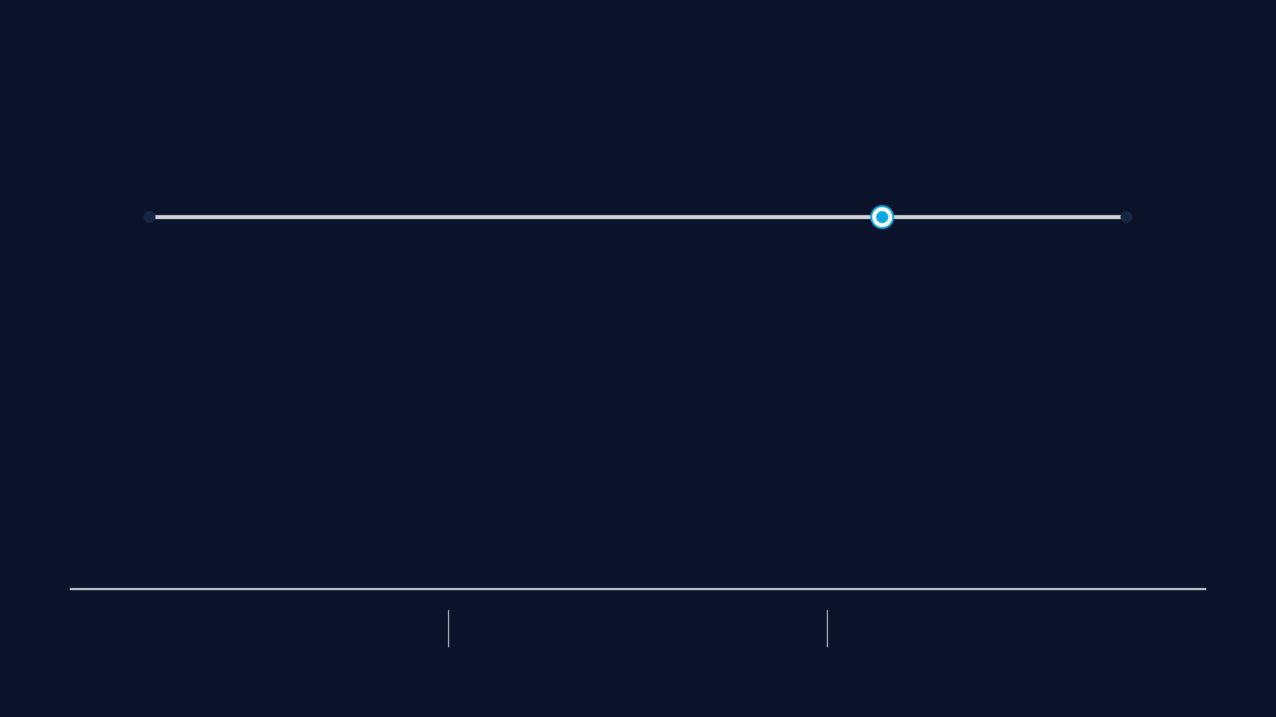
10. 0.75 Is a Line — But Real Fraud Is Not
CURRENT THRESHOLD
FRAUD PROBABILITY DECISION RULE
0.00
0.75
1.00
"Why does a continuous probability become a YES/NO decision at 0.75?"
1
PROBABILITY → DECISION
2
THE COST OF BEING WRONG
The threshold is an operational choice, not a universal law. It should match the specific investigation environment.
Missing one fraud (False Negative) vs. reviewing one extra genuine case (False Positive) have different costs.
3
INVESTIGATOR WORKLOAD
4
CALIBRATION MATTERS
The threshold must produce a volume of alerts that investigators can realistically review and act upon.
If the dashboard shows 80%, that number must remain meaningful even when data conditions change.
ESTIMATE
DECISION RULE
HUMAN PROCESS
Fraud Probability
The Threshold
The Investigation
10 / 12

Slide 11
11. SHAP Explains the Model — But What Should the Investigator Do With It?
MODEL
SHAP
"WHY THIS?"
INVESTIGATOR
"WHAT NEXT?"
1. MODEL ATTENTION
2. CAUSALITY VS. INFLUENCE
"What did the model notice?"
"Does SHAP mean the feature caused the fraud?"
Local SHAP shows which features (amount, balance depletion, ratios) pushed a prediction higher.
NO. SHAP explains the model's reasoning, not the real-world cause of the transaction.
Insight: Makes the black-box prediction interpretable.
Insight: Distinguish model logic from causal proof.
3. FORENSIC INTELLIGENCE
4. PATTERN MONITORING
"Can an explanation change an investigation?"
"Can explanations themselves be monitored?"
If SHAP flags balance depletion, the investigator knows exactly which financial history to check next.
If fraud patterns change, the features driving predictions will also shift over time.
Insight: Bridge "why flagged?" to "what to inspect?".
Insight: Monitor explanation patterns for concept drift.
Good explainability does not stop at "Why did the model flag this?"
It should help answer: "What should the investigator look at next?"
11 / 12

Slide 12
12. From a Model Output to a Forensic Story
TRANSACTION
FEATURES
RISK
THRESHOLD
SHAP
BEHAVIOR
PRIORITY
HUMAN
LAYER 1: DETECTION
LAYER 2: EXPLANATION
"Which transaction looks unusual?"
"Why did the model flag this?"
Machine Learning provides the initial risk estimate based on historical patterns.
SHAP provides feature-level contributions to make the prediction interpretable.
LAYER 3: BEHAVIOR
LAYER 4: FORENSIC PRIORITY
"Does the context support the concern?"
"Which cases deserve attention first?"
Behavioral profiling adds context beyond one isolated prediction.
Combines probability, behavior, and evidence to support human prioritization.
THE REAL VALUE IS NOT JUST DETECTING FRAUD. IT IS CONNECTING:
RISK + EXPLANATION + BEHAVIOR + EVIDENCE + PRIORITY
"The next meaningful test is whether these explanations and priorities actually help investigators review cases more effectively."
12 / 12

